Slide 1
Avanade DevOps Practitioner
Foundation of Avanade’s Engineering Discipline

Slide 2


Your Facilitators for this Series
Keith Lemon
Scott Anderson
Modern Engineering Platform Architect
Agile Quality Lead, DevOps & Agile Coach, PST, MCT

Slide 3




Expectations During Sessions
Share your experience and ask questions
Explore topics in the DevOps Practitioners series
Stay Engaged
Notes:
Sharing
We are now a team! Our goal as this newly formed team is help each other on this learning journey by sharing our experiences, ask insightful and thought-provoking questions, and when possible, support each other. We all have a lot to learn from each other and your engagement is key.
Productive and Directional
We will be supportive of each other on this learning journey, by being mindful of the questions and comments are directional to the material and questions/support needed for individual issues be kept brief. We will cover shortly how we will ask practitioners to capture any questions or support requests in the team's project.
Stay Engaged
To help everyone stay engaged we will try and mix it up through the series. You will have both Scott and I facilitating, but I look to have some guest speakers later in the series to talk about security and platforms like Cloud Solution Studios if scheduling works out.

Slide 4
Avanade DevOps Practitioner Series
Sessions
1 – Foundations of DevOps & Pre-work
2 – Tour of Azure DevOps, GitHub Enterprise, other tools
3 – Practice to create fast flow
4 – Practice to create fast and continuous feedback
5 - Practices to create opportunities for experimentation and continuous learning
6 - Security and compliance practices in engineering/delivery
Notes:
This series is broken up over three weeks. Each week we will meet twice for two and a half hours. Each week we will come together for five hours, and the total series of the three weeks will be fifteen hours.
There will also be chances between the sessions to connect with facilitators and other practitioners during a set of office hours. The office hours will be setup based on the need and are intended to support any questions or technical support practitioners may need.

Slide 5
Series Learning Objectives
Practitioners will learn to be comfortable speaking about DevOps in formal and informal communications
We will cover how DevOps is understood in the broader industry
We will cover how we at Avanade understand DevOps
Practitioners will learn how Avanade leverages DevOps from multiple phases including sells, solutioning, and delivery
Practitioners will learn about different offerings, approaches, and tools that are leveraged today for DevOps work
Practitioners will learn about Avanade’s DevOps Standard and Framework
Practitioners will learn how to apply DevOps patterns and practices with Azure DevOps, GitHub Enterprise, and other products/tools
At the end of the series, you will demonstrate during a one-on-one session basic practitioner skills.

Slide 6
Session 1 - Agenda
01
02
03
What is DevOps
Why is DevOps
People
04
05
06
Processes
Products
Hands-On Lab
Notes:
Needs to be updates

Slide 7
Introduction Activity
5 minutes
Quickly add a profile to introduce yourself to the team.

Slide 8
Learning Objectives Activity
5 minutes
Add 3 – 4 learning objectives as Feature’s to the team backlog. Assign yourself to the ones you create.
Notes:
https://dev.azure.com/ava-continuous-learning/DevOps%20Practitioner%20NA/_backlogs/backlog/Student/Epics/

Slide 9
Quick Demo of Course Mechanics
What is the best way for practitioners to engage?
Notes:
The mechanics of the course need to be outlined in the pre-work. If students haven’t reviewed by this time, we need to ask them to go back between breaks or after the course.
Learning Objectives
Questions
Impediements

Slide 10
Terminology
Agile – A team delivery methodology originally developed for software development. It encompasses multiple different frameworks such as Scrum, Kanban and Lean. Scaled Agile variations for multiple project teams include Scaled Agile Framework (SAFe), LeSS and Nexxus
DevOps - The union of people, process, and products to enable continuous delivery of value to end users. It is not a product
Modern Engineering – Avanade’s system engineering approach for the Microsoft ecosystem.
Azure DevOps – Microsoft’s premier DevOps tool chain platform
Git – A source control management protocol used in many products like Azure DevOps, GitHub, Github Enterprise, and many more
GitHub – A popular open-source developer platform with public and private projects with which Azure DevOps can integrate
GitHub Enterprise - a paid variation of the open-source platform incorporating enhanced features
CI/CD
Deployment – Act of installing and configuring a version into an environment
Release – associated with a checkpoint in a version control system, visible to an end user
Notes:
There are a lot of buzz words that are covered in this material, and we are going to attempt to make them real.

Slide 11
How Agile, DevOps, and Modern Engineering Relate
Modern Engineering
DevOps
PROJECT
PRODUCT
Agile
Development Start
Development End
Release
Production Support

Slide 12
What is DevOps
Boxing In DevOps
Notes:
I like to think of this section as exposure therapy. I want to reduce your distress around DevOps by bring to you many different industry perspectives and showing you that there isn’t anything to fear in DevOps.

Slide 13
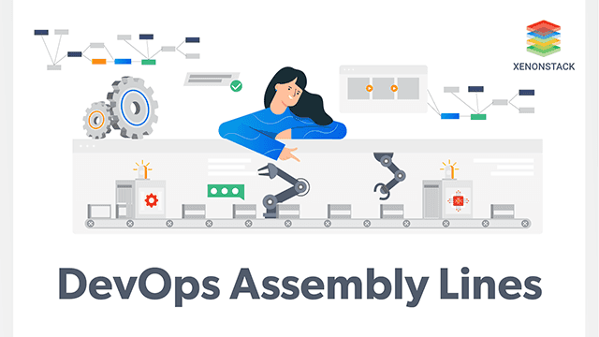
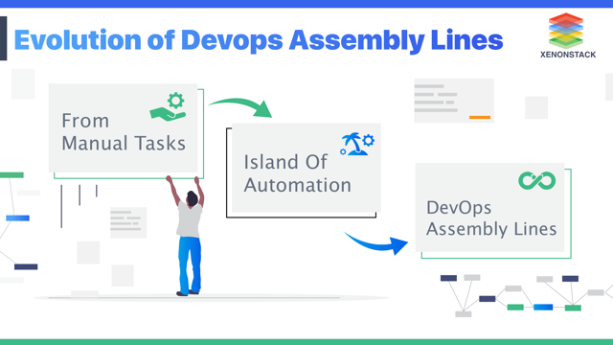
Draft
Notes:
DevOps is a cultural movement
DevOps empowers all members of the delivery team
DevOps is a collaborative approach to building and delivering systems

Slide 14



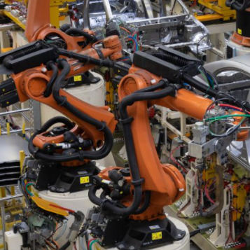
DevOps Assembly Line Analogy
Manual
Partly Automated
Assembly Line
Notes:
A good place to look for a comparable model is the automotive industry.
The auto industry went through an evolution to improve their efficiencies more than 100 years ago. Going from many car manufactures creating one of a kind custom built cars with manual processes. Taking experience from creating buggies for the prior era's mode of transport; the horse and buggy.

Slide 15
How DevOps is Understood From Wider Industry
The Three Ways as described in The Phoenix Project and The DevOps Handbook
CALMS (Culture, Automation, Lean, Measurement, Sharing) framework for assessing DevOps
The Theory of Constraints (TOC) as outlined in The Goal
Principles of DevOps as found in a variety of industry materials
Notes:
To ground ourselves for this series, it will be important that we have a firm understanding on how others may understand DevOps.
**Please be ready to engage at the end of this section as I would like to hear from the group on your experiences with DevOps.**

Slide 16
The Three Ways
DevOps breaks the core, chronic conflict between Development and Operations
DevOps requires (potentially) new cultural and management norms, between development & operations
DevOps is not just a technology imperative but also an organizational imperative
1
2
3
Flow
Feedback
Experimentation
Dev
Dev
Ops
Dev
Ops
Ops
Notes:
Flow – Increasing the flow from development to operations
Increased code quality builds trust, collaboration
Use cycle time as metric: measure time from introducing requirement to execution in production
Feedback – Open feedback from operations and end users back to development
Shared information and learning enhances value delivered
Leverage real-time monitoring and notification
Build fault tolerant applications and systems
Culture – Build, Measure, Learn: the Culture of High Performance
Possibly the most difficult challenge to adopting DevOps
Experiment and Fail Fast
Reduce Technical Debt

Slide 17
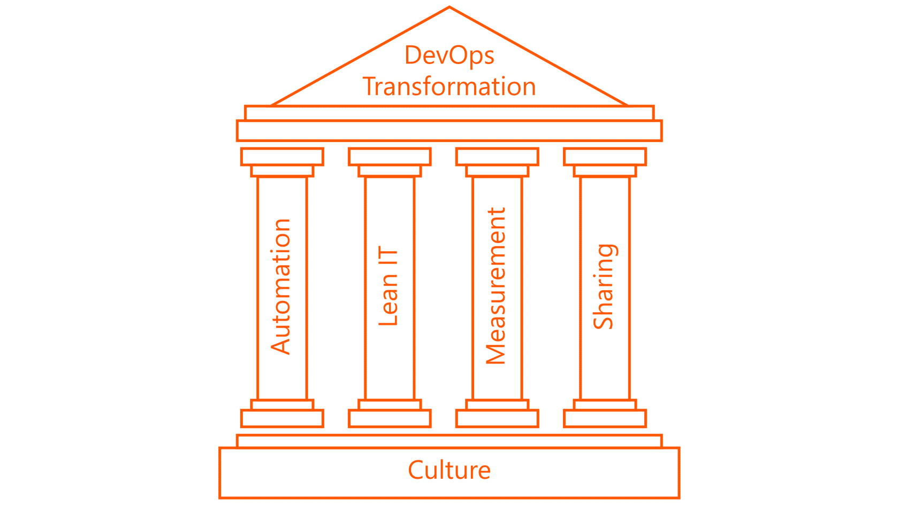
CALMS
Culture
Putting people and capabilities first; process and products to follow
Automation
The fabric of DevOps, built on top of culture; stitching together the products
Lean
Start and continuously improve
Measurement
If you can’t measure, you can’t improve
Sharing
Grown from a trusting culture of sharing ideas and problems; the feedback loop

Slide 18
Theory of Constraints (TOC)
Repeat
Exploit the Constraint
Subordinate and Synchronize to the Constraint
Elevate the Performance of the Constraint
Identify the Constraint
Identify the most important limiting factor (i.e., constraint) that stands in the way of achieving a goal and then systematically improving that constraint until it is no longer the limiting factor.

Slide 19
Common Principles of DevOps
Hyper-
Collaborative
Cohesive Teams
Automate
Everything
Everything from Source
Test Early &
Often
Continuously Improving
Deliver Small Increments
Shift-Left Security
Experiment Frequently
Notes:
We have extended the seven principles of DevOps to nine, to high-light a few things we thought important for Avanade.
Cohesive teams – Everyone working on shared goals, sharing knowledge and understanding
Encourages a high trust culture
Automate everything – Development and operations tasks can be automated
Essential for achieving fast flow
Strong Source Control -> Everything from Source – ensures integrity of the codebase, stores code and configurations
Pre-requisite for continuous integration (CI)
Test early and often – Shift testing left in the process to keep it closest to point of origin
Testing should be fully automated where possible
Continuous Improvement – review of progress and work to remove bottlenecks
Work to improve across all teams, not just within
Deliver small increments – Enables fast flow and fast feedback and impacts of each change are clear
Decreases risk and increase agility
Experiment frequently – Enables teams to use Build, Measure, Learn
Must be able to experiment without regret

Slide 20
Your Take…
Of the industry views of DevOps which best aligns with your practice today?

Slide 21
Common Myths Surrounding DevOps
DevOps is more than just creating one team with all skills – you cannot reorg yourself out of the problem.
There is not “one toolset” that is better than others – the more time you spent on tool selection the more time you are wasting on starting to learn
DevOps implementations don’t show only positive results – there will be new failures resulting from new behaviours and results might get worse before they get better or dip along the way, you have to stay the course to be successful
DevOps practices are not sticky – without ongoing attention you will slip backwards
DevOps practices cannot just be implemented they require a change of behaviour, culture and process - Change Management for developers and testers and other stakeholder is crucial
DevOps is not one thing – you will need to make small changes and adopt and adapt practices step-by-step rather than going all-in with everything in one go
All flexible or one standard for all approaches are not appropriate – you will have to find the right balance
Anything short of zero-touch is NOT “pretend DevOps”. Even supposedly one-button push pipelines have a lot of manual processes.
Notes:
** Starting thinking through your experience as I will be looking to hear from the group shortly **

Slide 22
All about that Ops, no traditional…
DevSecOps
ITOps
NetOps
SecOps
DataOps
AIOps /
MLOps
ChatOps
NoOps
…
Notes:
DevOps (Development and Operations):
DevOps is the practice that aims to erode the barriers between development and operations teams. So that they work as a single unit with the goal of designing, developing, deploying, and supporting software applications within organizations.
DevSecOps (Development, Security, and Operations):
DevSecOps grew out of DevOps due to the realization that security was core to everything in IT and application delivery. Security needed to be thought about and designed into all application development, and infrastructure designs to host applications from the start. Rather than bolted on later. So, core security experts became part of the team.
ITOps (Information Technology Operations) / TechOps (Technology Operations):
These two terms get used interchangeably. ITOps is mostly used to describe the IT functions performed outside of application development and management. Tasks that fall into most ITOps definitions are related to network infrastructure & security, remote access provision, server management, device provision & management, help desk, and data integrity via backups plus similar activities.
NetOps (Network Operations):
NetOps looks to bring the network operations teams together with other groups to ensure that the correct information is fed into network operations and planning.
SecOps (Security Operations):
SecOps looks to combine security experts with ITOps or NetOps teams to ensure that security is core to all decisions and plans. Like all Ops groupings, it aims to automate security to reduce overhead and the risks of not implementing proper security processes.
DataOps (Data Operations):
The large amounts of data produced today is an essential resource across all industries and government sectors. Techniques to use all this data to provide better products and services are driving the update of data science and machine learning (see below).
ChatOps (Chatbot Operations):
There is a global trend in organizations towards using chatbots to provide services to clients. These chatbots are often backed by machine learning based algorithms or expert systems that have hardcoded business intelligence. The chatbot systems try to handle queries completely, but if they can’t they pass the requests on to human operators in call centers. The infrastructure to provide a global chatbot and call center infrastructure is complex. The field of ChatOps is emerging to provide best practices and solutions to deliver chatbot infrastructure.
NoOps (No Operations):
NoOps is the ultimate goal for IT operations. NoOps looks to automate everything related to IT work so that no operations team input is needed at all! From development workflows to security checking code, to testing, deployment, system monitoring, updating, and issues response. All would be automated and expected to function without human intervention. Many people see this as an impossible task. But certainly, the idea of automating everything that can be automated is a worthy goal.
All the Ops – What are They? Kemp Technologies.

Slide 23

A Word of Warning
DevOps is an overloaded term with many meanings. It is important we are precise when communicating about DevOps.
Notes:
A challenge we all face when attempting to express clear meaning when using the term DevOps is its abstract nature that we can see from the different ways the term is expressed.
The special feature of a term is that even though it may have a general meaning, it is different from the meaning with which it is associated in a particular discipline. The nature of it morphing based on context or disciplines is something we need to be cautious.

Slide 24
Your Take…
Have you run into any challenges with
the term DevOps, or have you seen others challenged?

Slide 25
At Avanade …
DevOps brings people, processes, and products together to enable the continuous delivery of value to our clients.
Notes:
We leverage DevOps to bring together members from our different Talent Communities and Global Solution Areas in cross-functional teams on our projects to shorten the time to deliver value and achieve business outcomes in a smooth and consistent way for our clients.

Slide 26
State of DevOps 2020
Perhaps a few years from now, the term ‘DevOps’ will sound quaint — even fade away.
Notes:
because so many people and organizations have fully adopted the DevOps principles of collaboration, communication, small-batch iteration, feedback loops, continuous learning and improvement

Slide 27

5 minutes

Slide 28
Why is DevOps

Slide 29
Why DevOps
IT Efficiency
Δ Value
Δ Time
Reduces Time by helping people work faster
Reduces Time by removing extra work and wait times during handoff
Reduces Time by removing time take for unplanned work
Increase Value by improving requirement accuracy
Reduce Rework
Decrease Lead Time
Improve Delivery Value
Notes:
“… evidence refutes the bimodal IT notion that you have to choose between speed and stability — instead, speed depends on stability, so good IT practices give you both.” --Accelerate
Link to state of devops report?

Slide 30
Helps Address Silos
Sec
Team
Data
Team
Sec
Team
Data
Team
Dev Team
Support Team
Dev
Team
DevOps
Support
Team
Ops Team
Ops
Team
Old IT
Siloed & segregated teams lead to inefficient communications and co-operation – furthermore, each team has different, and often opposing philosophies, objectives & priorities High cost / high turnover contractor workforce Fragmented delivery teams organised by skills Dev Team typically do not understand production environment sufficiently to develop the right monitoring, deployment, security, etc. solutions Long lead times and production quality issues
New Current IT
Empowered co-located teams with shared objectives aligned to customer journeys Lean principles and continuous delivery of value: Continuous Deployment: Continuous Improvement Test early and often: Embrace failure, recover automatically, degrade gracefully; Experiment without regret Tools and automation: Enabling Zero-touch build and deploy, Automate everything (in pipelines), Elastic infrastructure and platform services, API enabled architecture
Notes:
It is Dr. Eliyahu Moshe Goldratt that coined the “core, chronic conflict” to identify organizations that measure and incentivize across different departments or silos which prevent achievements of global, organizational goals.
The Three Acts – see 459 DevOps Handbook –
Operations goal is to keep applications running but technical debt and workarounds are constantly sucking up resources so there is no time to fix it and do it right.
Someone has to compensate for the broken promise – a product manager promising a new feature to appease customers, management committing to higher revenue targets. This results in another urgent project solving new technical challenges with an unrealistic deadline. “Get it out now – we’ll fix the problems later”
Final act – everything becomes more difficult. Communications become slower, work queues become longer, more approvals are required, less new functionality is being produced, heroics are required to keep system alive. Finally, something happens that causes the fragile system to break, and it all gets thrown out to start over or outsourced.
The cycle must be broken

Slide 31
Breaking the Downward Spiral
Code deployments should be routine and predictable
Code & environments are always in secure & deployable state
Feedback loops everywhere
Are users getting the right value?
Automated testing
Fix problems - don’t manage them
Pervasive production telemetry
Proactive vs. Reactive
Blameless post-mortems
Instill culture of learning
Inject faults on purpose
See how production reacts
Continual evidence-based Learning
& fostering Hypothesis-driven culture*
Notes:
* Hypothesis-driven culture = scientific method is used to ensure nothing is taken for granted. We do nothing without measuring and treating product development and process improvement as experiments. Blameless post-mortems are very important to instil this culture.
Index 560

Slide 32
People

Slide 33
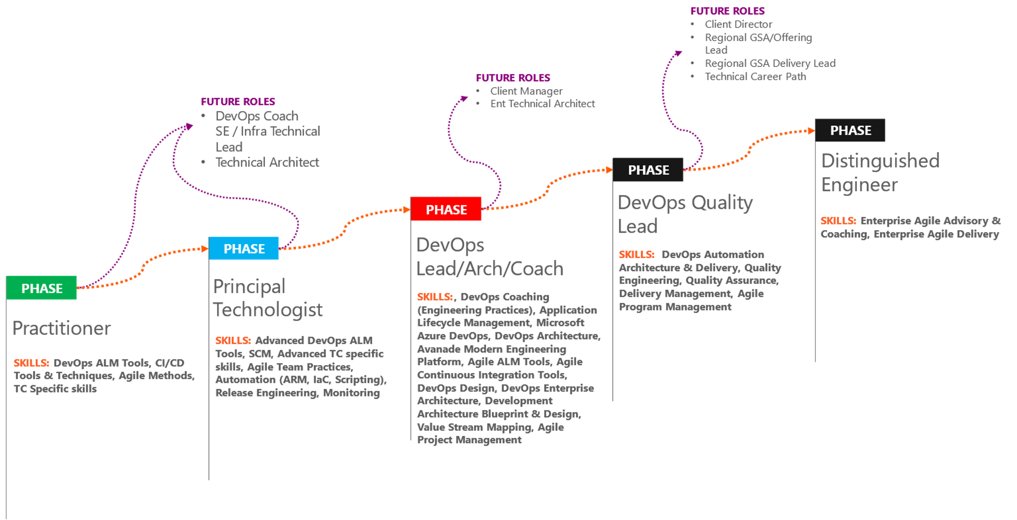
DevOps Practitioner Journey
Notes:
Analysts and Consultants at Avanade commonly land in the Practitioners and Technologist cohorts, respectively. At these phases of career development, we recommend members continue to develop their primary competencies as these skills are the foundation of our team's ability to deliver.

Slide 34
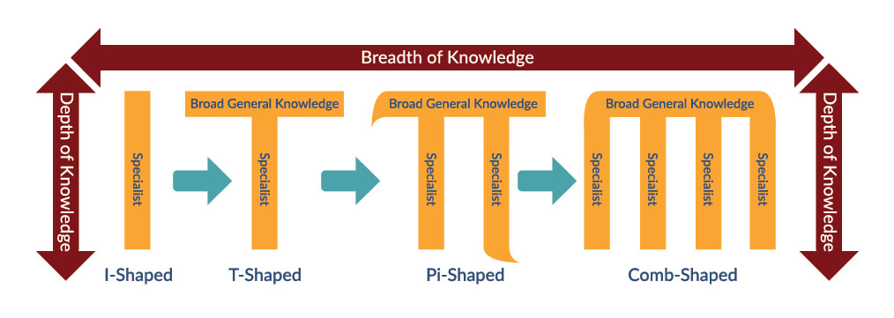
What is the Journey?
Notes:
At Avanade we align to Talent Communities. These talent communities group us together with other people with common skills which supports our ability to hone our skills. When we focus exclusively on those specific areas, we refer to that as being I-Shaped. There is nothing wrong with being super deep in a specific area, but we are advocating in this series is to increase our breadth of knowledge.

Slide 35
Processes

Slide 36
Your Take…
Who has hearing about the Avanade DevOps Standard session?

Slide 37
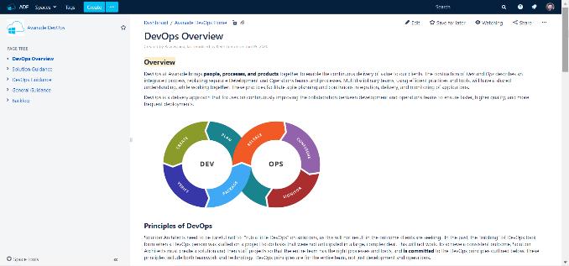
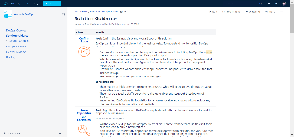
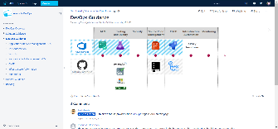
Avanade DevOps Standard
https://adf.avanade.com/display/ADO/DevOps+Overview

Slide 38
DevOps Standard Benefits Avanade by
Focus on value adding activities
Industrialization
Be more productive
Reducing errors
Lowering stress
Deployment flexibility
Empowering teams
Fast feedback
Less risk
Low cycle times
Less manual work
Reduced Cost-To-Serve (CTS)
Notes:
To ground ourselves for this series, it will be important that we have a firm understanding on how others may understand DevOps.

Slide 39
Key Takeaways & asks
Takeaways Asks
Formalized, DevOps standardized
Clear cut guidelines
This is expected to result in qualitative SDLC, governance, compliance and reporting (scorecard, metrics etc)
With framework clearly defined, solution shaping for including DevOps will be smooth and projects may be run effectively thereby reducing Cost-To-Service in the long run
DevOps is a default framework which is mandated for all SI projects, it's not optional but mandatory
All deals being solution shaped currently must mandatorily have DevOps as part of solution as per this framework
We are not selling DevOps here in this framework, but making DevOps part of our solution as it enables client and Avanade/ Accenture to be successful
Notes:
To ground ourselves for this series, it will be important that we have a firm understanding on how others may understand DevOps.

Slide 40
Avanade Engineering Guidance (AEG)
NEED TO UPDATE
https://adf.avanade.com/display/ADO/DevOps+Overview

Slide 41
Products

Slide 42

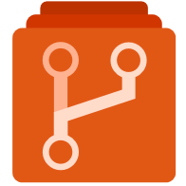



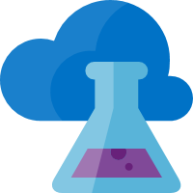



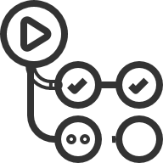














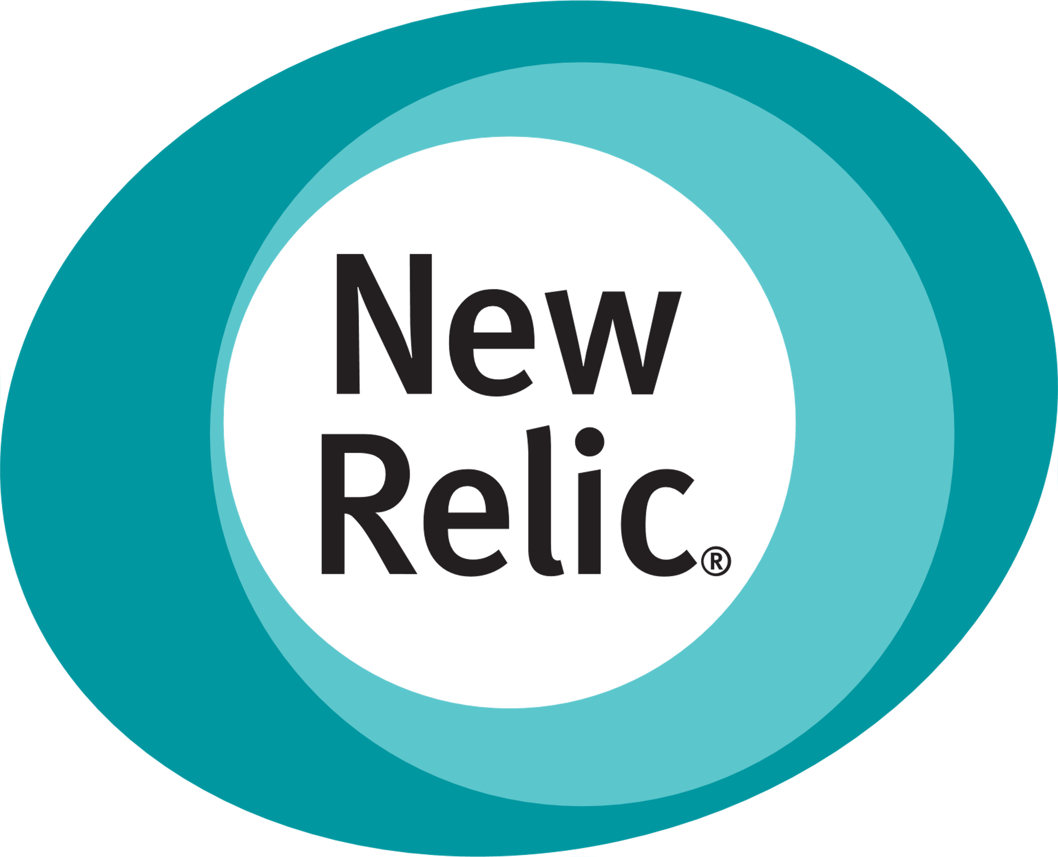
Toolchain Overview
Azure DevOps
Azure Boards
Azure Repositories
Azure Pipelines
Azure Test Plans
Azure Artifacts
Azure DevTest Labs
Azure
Application Insights
GitHub
Azure
DevTest Labs
Application Insights
Projects
Repositories
Actions
Packages
Jira
Bitbucket
Jenkins
JMeter
JFrog
Sauce Labs
Dynatrace
Alternatives
GitLab
Gogs
CircleCI
Gatling
Docker Hub
BrowserStack
New Relic
Notes:
https://about.gitlab.com/devops-tools/azure-devops-vs-gitlab.html
Boards:
Azure Boards: Tagging & Hierarchies
Jira: Issue tracking product developed by Atlassian that allows bug tracking and agile project management.
GitLab: Web-based opensource DevOps tool.
Repos:
Azure Repositories: Git & TVC; Mixed mode possible
Bitbucket: Web-based version control repository hosting service owned by Atlassian. Integrates well with other Atlassian products (Jira, HipChat, Bamboo)
Gogs: Open source light weight git server written in Go. Offers repository file viewing and editing, project issue tracking, and a built-in wiki for project documentation.
Pipes:
A Continuous Integration Pipeline is a powerful instrument that consists of a set of tools designed to host, monitor, compile and test code, or code changes.
Azure Pipelines: Deployments can be blocked, pending approval or gated using custom checks programmatically via custom code; integration of a variety of other services
Jenkins: Open source automation tool written in Java.
Circle CI: Continuous integration and continuous delivery (CI/CD) platform. Automates build, test, and deployment of software.
Test Plans:
Azure Test Plans: fully integrated into web-interface;
Apache JMeter: Open source software written in Java designed to load test functional behavior and measure performance.
Gatling: Open source load and performance testing tool for web applications based on Scala, Akka, and Netty.
Artifacts:
Azure Artifacts: Provide artifacts to external projects. (Pipeline artifacts are not presented here, but storage is used in background)
JFrog Artifactory: Universal repository manager designed to store binary output of the build process for use in distribution and deployment.
Docker Hub: Cloud-based repository to create, test, store, and distribute container images. Very Docker-centric.
Dev Test Lab:
Azure Dev Test Lab:
Sauce Labs: Cloud-based web and mobile application automated testing platform. Allows users to run tests in the cloud on more than 700 different browser platform, operating system and device combinations.
BrowserStack: Cloud-based web and mobile application automated testing platform. Allows users to run tests in the cloud on more than 1,200 different browser platform, operating system and device combinations.
Insights:
Azure Insights:
Dynatrace: Provides application performance management, artificial intelligence for operations, cloud infrastructure monitoring, and digital experience management. Offers deep transaction tracing, synthetic monitoring, real user monitoring, and network monitoring.
New Relic: Monitors web and mobile application in real-time with support for custom-build plugins to collect arbitrary data.

Slide 43

The GitHub Story
2008
20/21/…
LAUNCHED
Closing gaps
GitHub started its journey as platform for code and basic software project management
Implement missing features and move infrastructure for leading brand switch
2018
acquired
Microsoft announced and closed the takeover within less than 6 month, after increasing open-source strategy

Slide 44
Avanade’s GitHub Enterprise strategy is…
Avanade’s public facing GitHub Account is providing demo solutions and open source projects
Notes:
https://github.com/enterprises/avanade
GitHub Enterprise channel in Modern Engineering MS Teams link
Rollout status as of 2nd week of June 2021
Security review completed
Remediation tasks that are being worked through

Slide 45
5 minutes

Slide 46
Hands-On Lab
SmartHotel360

Slide 47
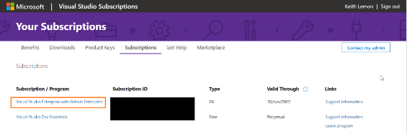
Check Your Visual Studio Subscription
The first thing you need to check is if you have a Visual Studio (MSDN) subscription. Some will have this associated with their Avanade email and others will be associated to a Microsoft Live account, please check both. To validate your subscription, navigate to https://my.visualstudio.com/Subscriptions . Once you are there, you should see either a Visual Studio Professional or Enterprise subscription that is currently valid.

Slide 48
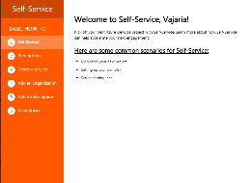
Technology Foundations – demo & conversation
Modern Engineering Self Service Portal (MESSP) https://messp.avanade.com
1:28 min intro video on home page
Marketplace – Tutorial walkthrough
Setup your learning lab for this course
Create/Identify Azure DevOps Organization you will be using (use your Avanade id)
Identify your Azure Subscription will you be using (Visual Studio Subscription benefit)
Create an SPN link
Using MESSP, create a team project based on SmartHotel360 Asset
Let the pipeline and release run
View Azure Resources created, navigate to web app

Slide 49
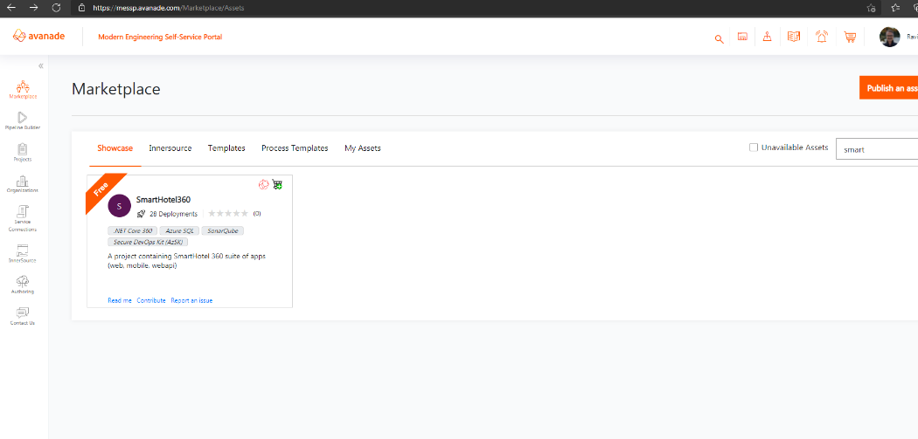
Notes:
Search for smart.. Select SmartHotel360, Add to cart or Provision now.

Slide 50
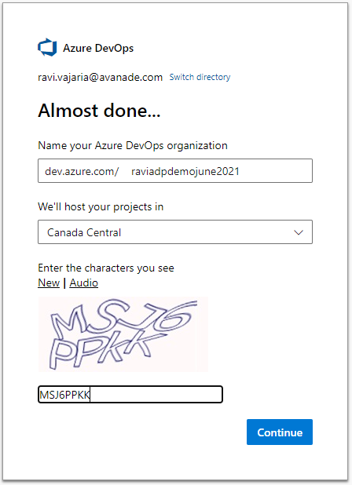
Create new Azure DevOps Org if needed

Slide 51
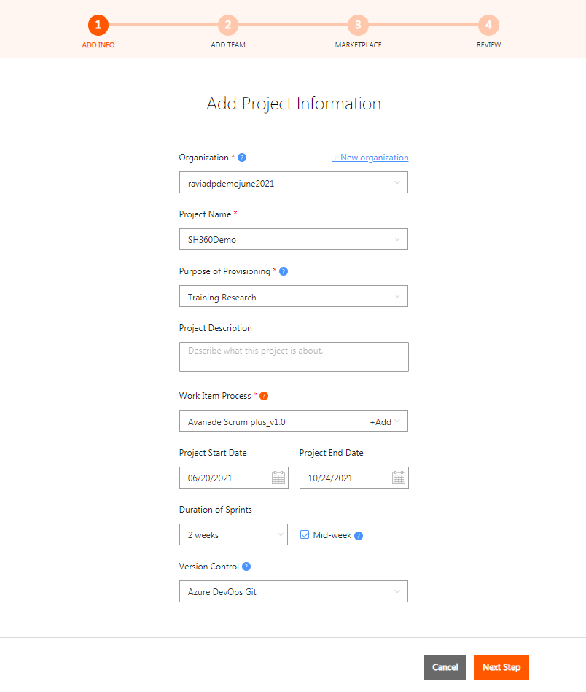
Add Project Information

Slide 52
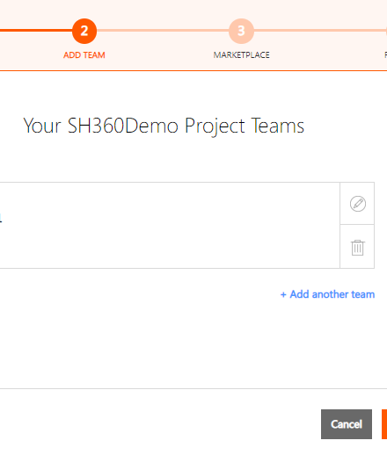
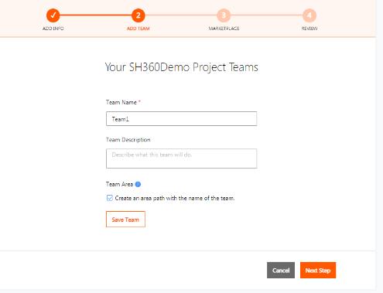
Add Team

Slide 53
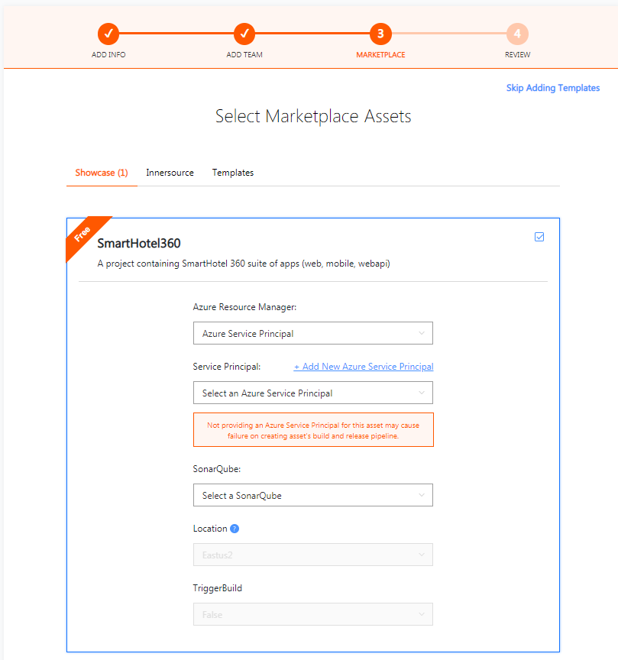
Add Service Principal
Notes:
We will be running a script to get the information needed to add Azure Service Principal

Slide 54
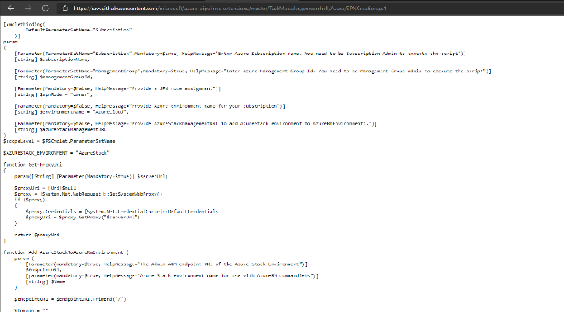
Copy Script
https://github.com/Microsoft/azure-pipelines-extensions/blob/master/TaskModules/powershell/Azure/SPNCreation.ps1

Slide 55
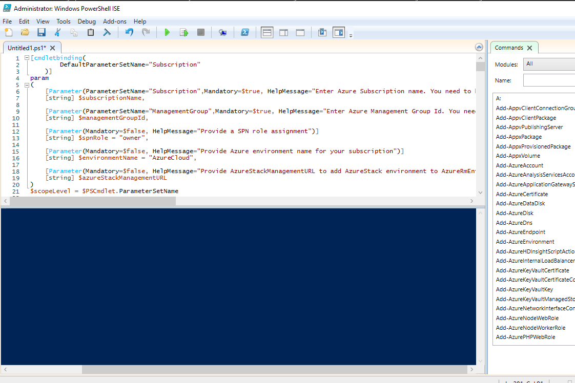
Open PowerShell ISE as Admin and run copied script

Slide 56
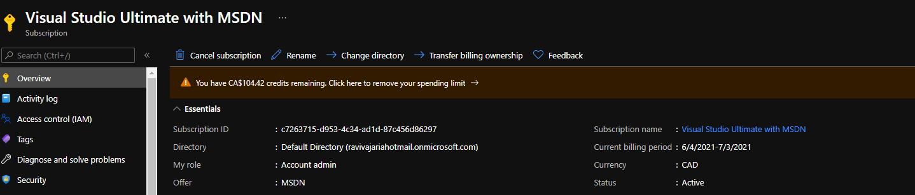
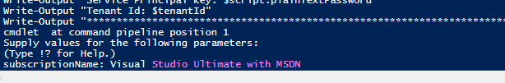
Subscription name
Press Enter

Slide 57
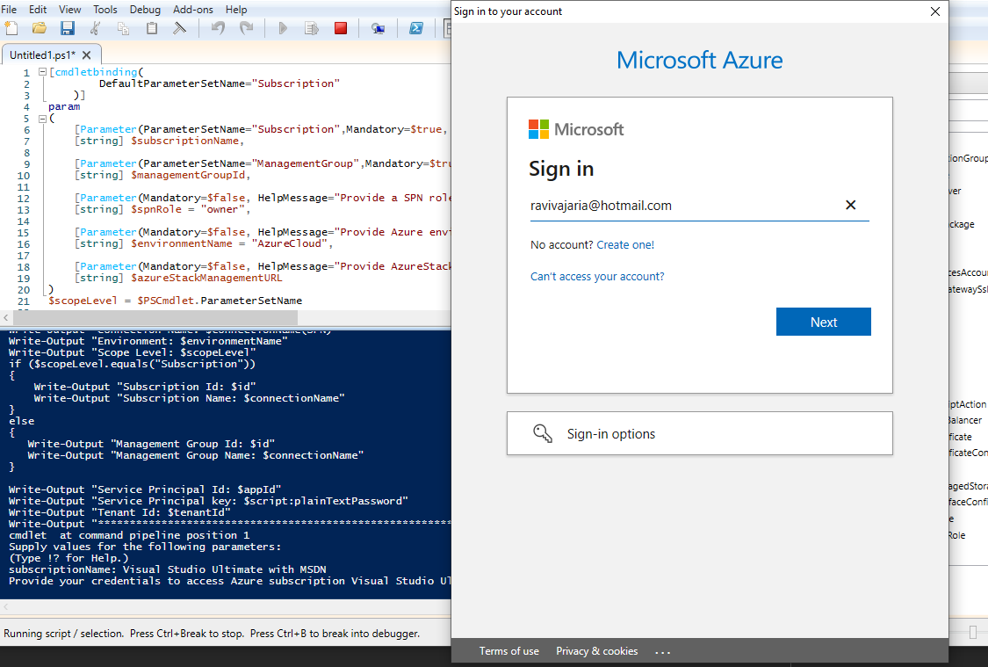
Sign in

Slide 58
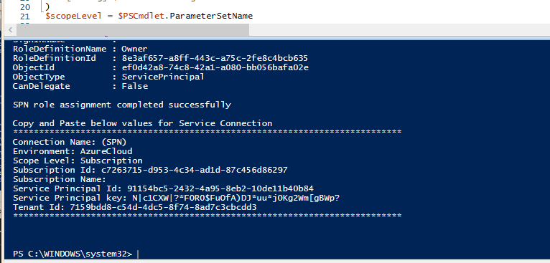
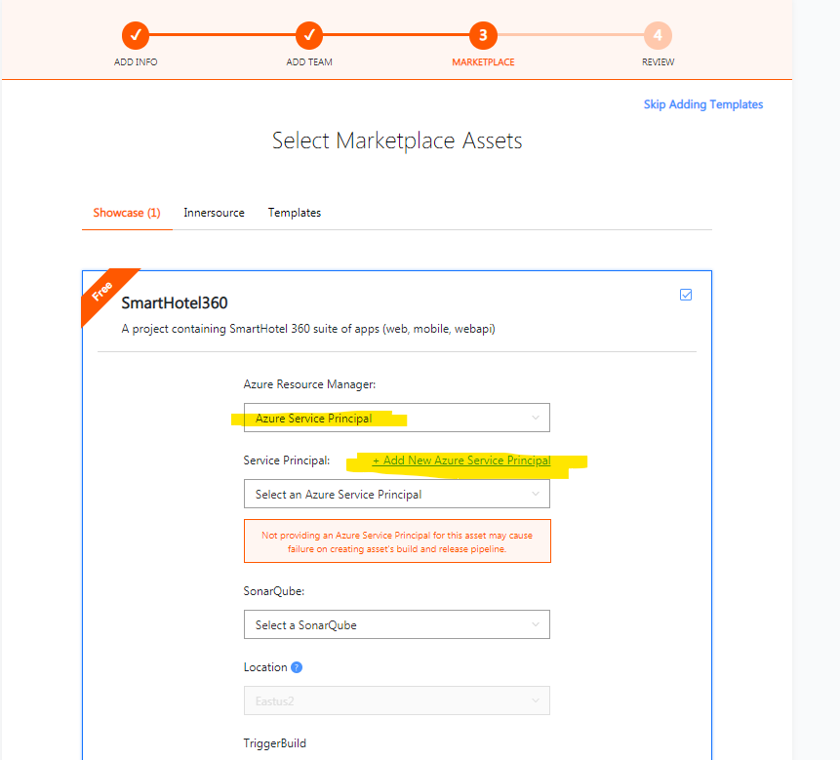
Let the script run, use this information in MESSP to add Azure Service Principal

Slide 59
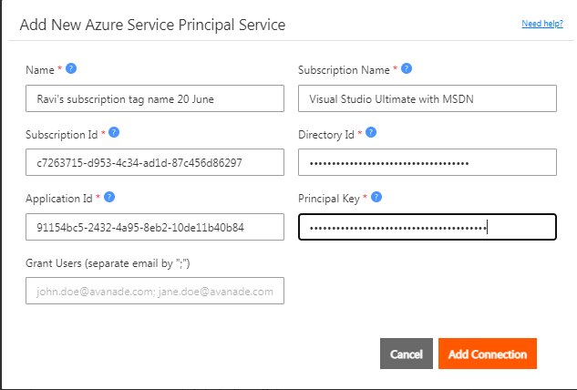
Let the script run, use this information in MESSP to add Azure Service Principal
NOTE: If subscription / Azure Service Principal was already added earlier, you will need to remove it

Slide 60
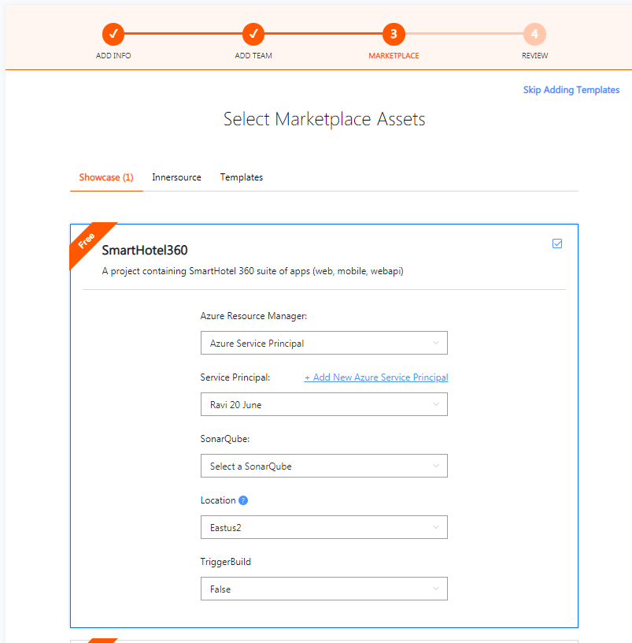

Scroll down

Slide 61
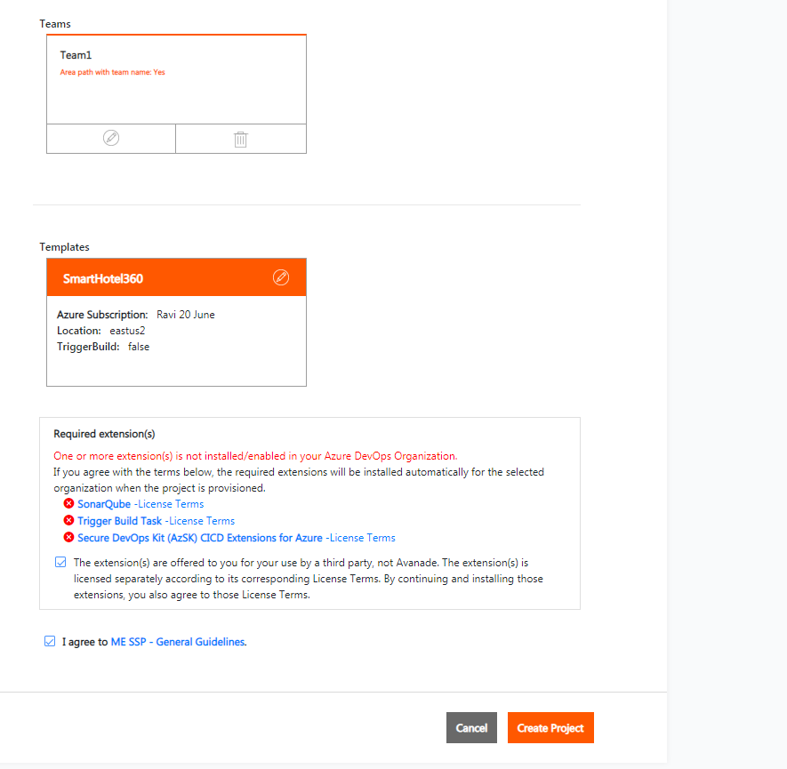

Slide 62
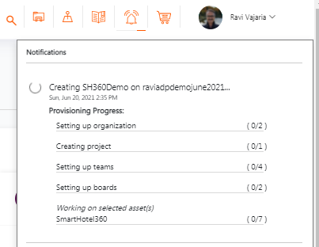
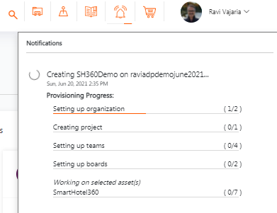
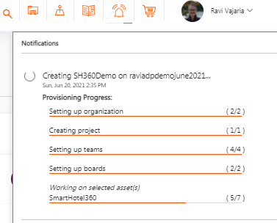
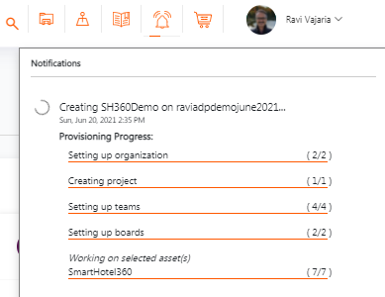
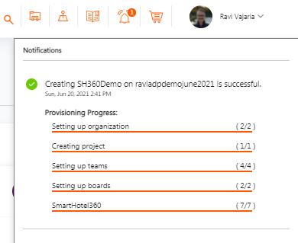

Slide 63
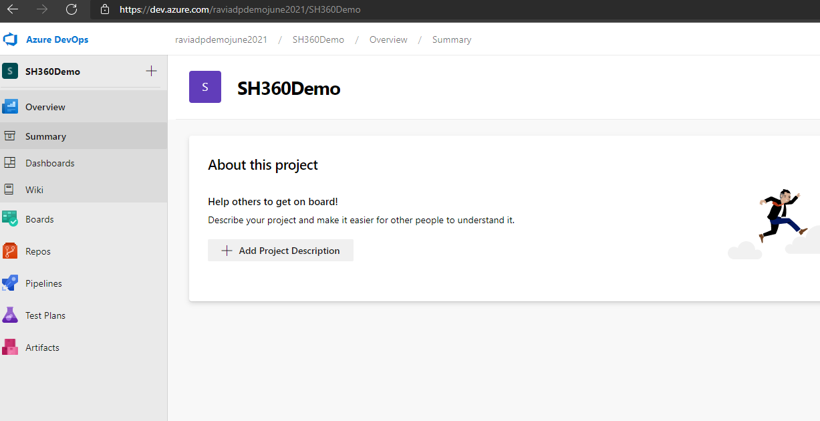

Slide 64
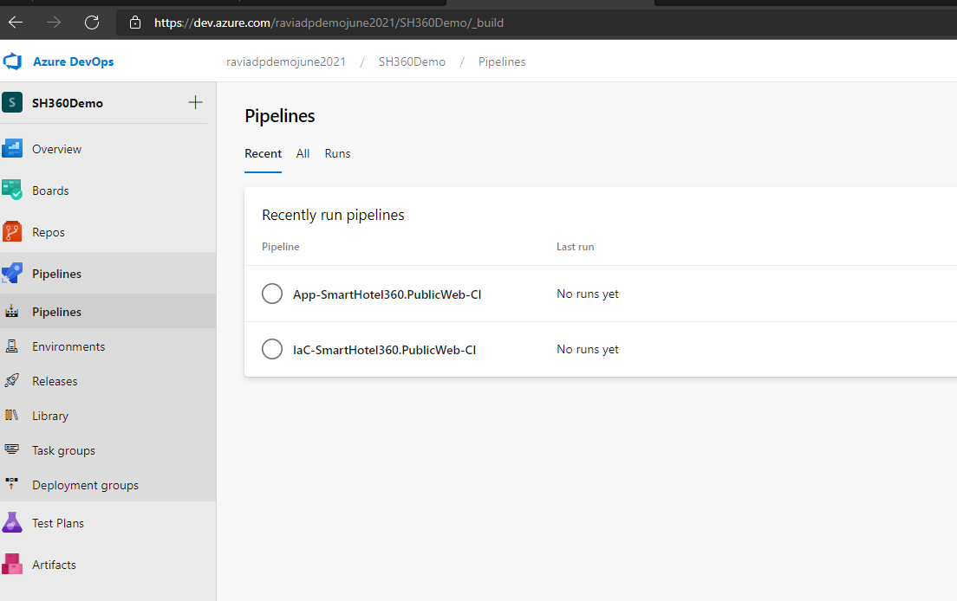

Slide 65
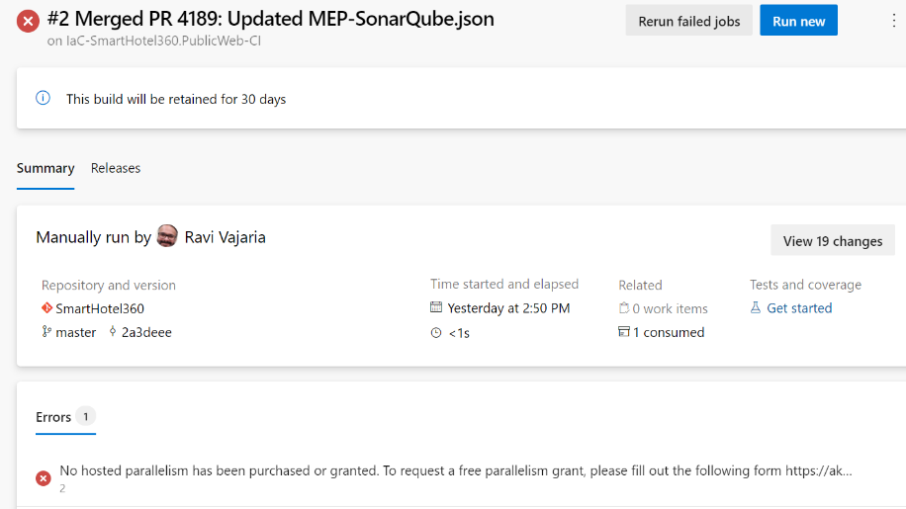
Change in Azure Pipelines Grant for Private Projects | Azure DevOps Blog (microsoft.com)
Change in Azure Pipelines Grant for Public Projects | Azure DevOps Blog (microsoft.com)

Slide 66
Business
Transformation
A
L
M
S
C
DevOps Transformation
Notes:
Supporting Material Slides

